Slide 1



Slide 2
RECAP time!

Slide 3
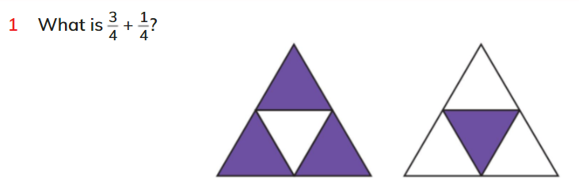
Recap skills time
Notes:
🍐 This is a Pear Deck Drawing Slide
🍐 To edit the type of question, go back to the "Ask Students a Question" in the Pear Deck sidebar.

Slide 4
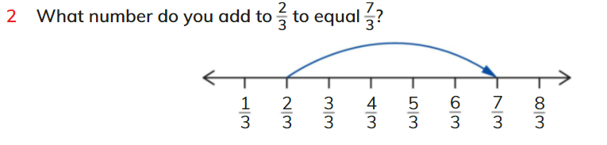
Recap skills time
Notes:
🍐 This is a Pear Deck Drawing Slide
🍐 To edit the type of question, go back to the "Ask Students a Question" in the Pear Deck sidebar.

Slide 5

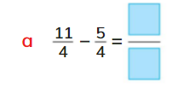
Recap skills time
Notes:
🍐 This is a Pear Deck Drawing Slide
🍐 To edit the type of question, go back to the "Ask Students a Question" in the Pear Deck sidebar.

Slide 6
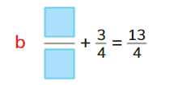
Recap skills time
Notes:
🍐 This is a Pear Deck Drawing Slide
🍐 To edit the type of question, go back to the "Ask Students a Question" in the Pear Deck sidebar.

Slide 7

Recap skills time
Notes:
🍐 This is a Pear Deck Drawing Slide
🍐 To edit the type of question, go back to the "Ask Students a Question" in the Pear Deck sidebar.

Slide 8
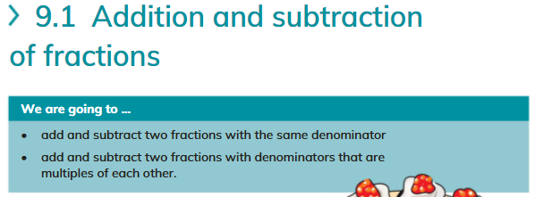
Notes:
🍐 This is a Pear Deck Drawing Slide
🍐 To edit the type of question, go back to the "Ask Students a Question" in the Pear Deck sidebar.

Slide 9
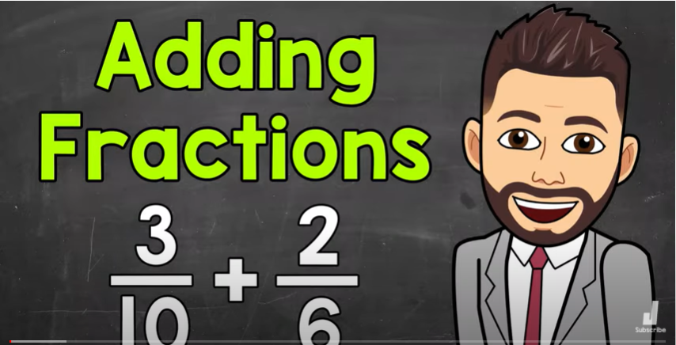
Notes:
🍐 This is a Pear Deck Drawing Slide
🍐 To edit the type of question, go back to the "Ask Students a Question" in the Pear Deck sidebar.

Slide 10
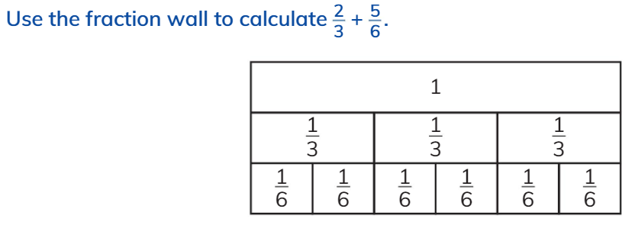
Notes:
🍐 This is a Pear Deck Drawing Slide
🍐 To edit the type of question, go back to the "Ask Students a Question" in the Pear Deck sidebar.

Slide 11
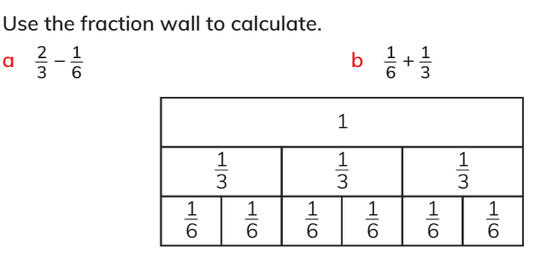
Notes:
🍐 This is a Pear Deck Drawing Slide
🍐 To edit the type of question, go back to the "Ask Students a Question" in the Pear Deck sidebar.

Slide 12
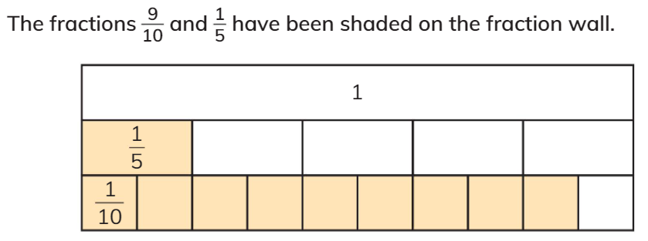
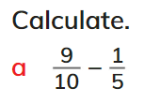
Notes:
🍐 This is a Pear Deck Drawing Slide
🍐 To edit the type of question, go back to the "Ask Students a Question" in the Pear Deck sidebar.

Slide 13

Notes:
🍐 This is a Pear Deck Drawing Slide
🍐 To edit the type of question, go back to the "Ask Students a Question" in the Pear Deck sidebar.

Slide 14

Notes:
🍐 This is a Pear Deck Drawing Slide
🍐 To edit the type of question, go back to the "Ask Students a Question" in the Pear Deck sidebar.

Slide 15

Notes:
🍐 This is a Pear Deck Drawing Slide
🍐 To edit the type of question, go back to the "Ask Students a Question" in the Pear Deck sidebar.

Slide 16




Notes:
🍐 This is a Pear Deck Drawing Slide
🍐 To edit the type of question, go back to the "Ask Students a Question" in the Pear Deck sidebar.

Slide 17

Notes:
🍐 This is a Pear Deck Drawing Slide
🍐 To edit the type of question, go back to the "Ask Students a Question" in the Pear Deck sidebar.

Slide 18

Notes:
🍐 This is a Pear Deck Drawing Slide
🍐 To edit the type of question, go back to the "Ask Students a Question" in the Pear Deck sidebar.

Slide 19
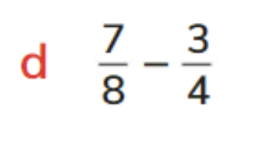
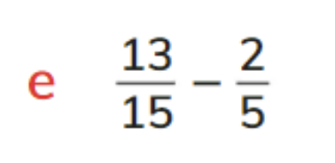
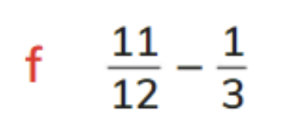

Notes:
🍐 This is a Pear Deck Drawing Slide
🍐 To edit the type of question, go back to the "Ask Students a Question" in the Pear Deck sidebar.

Slide 20
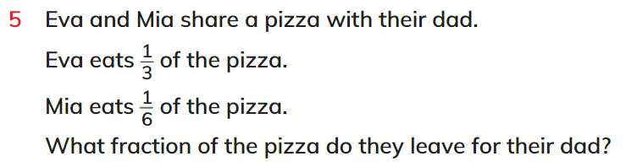
Notes:
🍐 This is a Pear Deck Drawing Slide
🍐 To edit the type of question, go back to the "Ask Students a Question" in the Pear Deck sidebar.

Slide 21
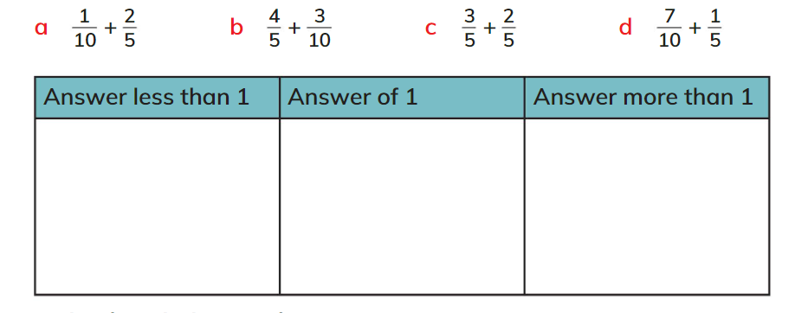
Put these into the correct boxes
Notes:
🍐 This is a Pear Deck Drawing Slide
🍐 To edit the type of question, go back to the "Ask Students a Question" in the Pear Deck sidebar.

Slide 22

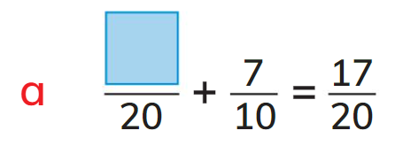
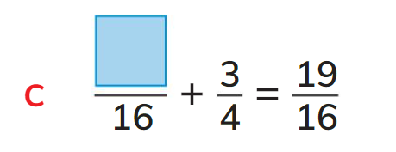
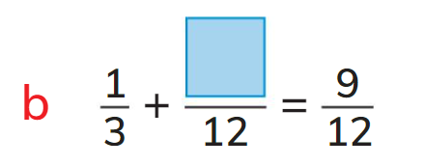
Notes:
🍐 This is a Pear Deck Drawing Slide
🍐 To edit the type of question, go back to the "Ask Students a Question" in the Pear Deck sidebar.

Slide 23
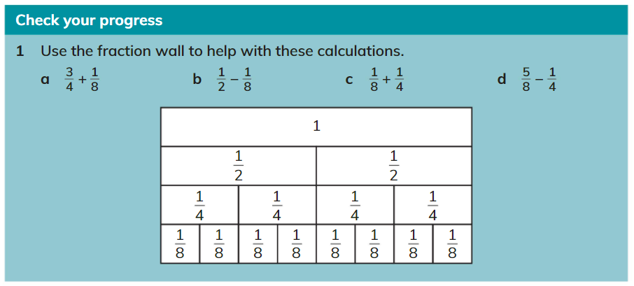
Notes:
🍐 This is a Pear Deck Drawing Slide
🍐 To edit the type of question, go back to the "Ask Students a Question" in the Pear Deck sidebar.

Slide 24
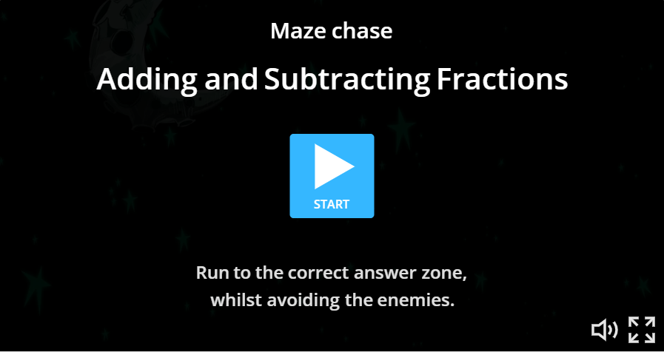
Notes:
🍐 This is a Pear Deck Drawing Slide
🍐 To edit the type of question, go back to the "Ask Students a Question" in the Pear Deck sidebar.

Slide 25
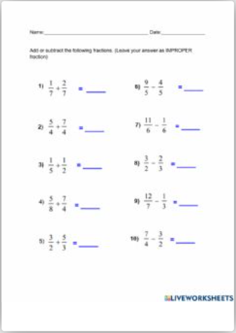
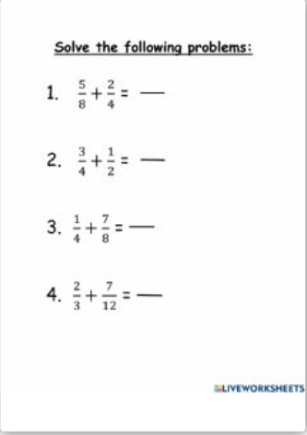
Try these live worksheets to test your skills!
Notes:
🍐 This is a Pear Deck Drawing Slide
🍐 To edit the type of question, go back to the "Ask Students a Question" in the Pear Deck sidebar.

